Slide 1

Networking
ECT 424/IS 324
Module 2

Slide 2
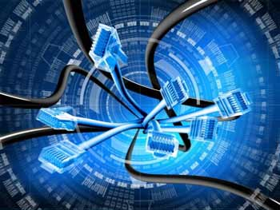
IT Components
Underlying Infrastructure (cabling)
Local Area Networks (connected devices)
Wide Area Networks (collections of networks)
Data Centers (devices providing services)
Internet access (Cloud and remote access)

Slide 3

Last Class
We covered
Shifting Roles of IT
Models
OSI vs TCP/IP
Nodes (hardware)
Computer Parts
Make sure you are making your D2L comments (2/week)

Slide 4
Recap - Shifting Skills in IT
With a Push from Cloud Computing, IT is becoming more of a SUPPLY CHAIN than traditional infrastructure.
That is why three-quarters (72%) of IT managers say their IT organizations are focusing more time on managing outsourced IT or cloud services providers than they were five years ago.
Notes:
More than half (54%) of the respondents in the Global Market Pulse Survey acknowledged that the current
value of IT is largely defined by its role as the owner and operator of the IT infrastructure.
Within two years, however, respondents believe the primary value of IT will come from managing the IT supply chain.
This explains why nearly three-quarters (72%) of IT managers say their IT organizations are focusing more time
on managing outsourced IT or cloud services providers than they were five years ago.

Slide 5
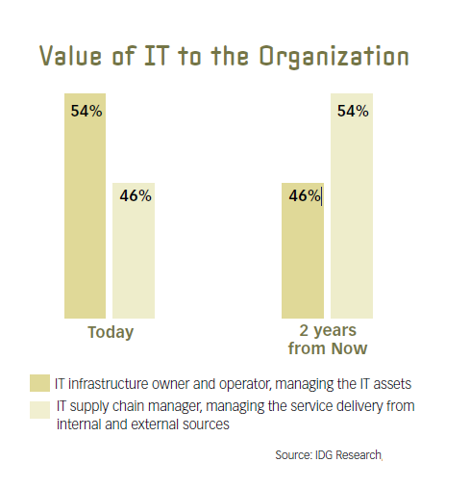
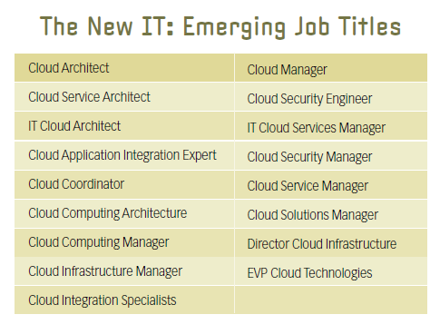
Recap - Shifting Skills in IT
The IT supply chain manager will manage the service delivery of IT from both internal and external sources
The importance of business knowledge, process standardization, expertise, cloud expertise, the ability to manage service providers, and communication skills has increased for the majority of IT respondents (particularly in the U.S.)
“The IT center of the future is one that combines cloud when necessary, on premise when it’s useful, virtualization when applicable.
All these resources need to connect together to best serve business needs.”
— Gerardo Dada, Director of Product Marketing Rackspace Hosting

Slide 6
OSI Model
 | Data unit | Layer | Function
Host layers | Data | 7. Application | Network process to application (end user layer)
 |  | 6. Presentation | Data representation, syntax layer, encryption and decryption, convert machine dependent data to machine independent data
 |  | 5. Session | Interhost communication (logical ports)
 | Segments | 4. Transport | End-to-end connections and reliability, (Host to Host, Flow control)
Media layers | Packet | 3. Network | Path determination and logical addressing (“letter” containing IP address)
 | Frame | 2. Data Link | Physical addressing (“Envelopes” contain MAC address)
 | Bit | 1. Physical | Media, signal and binary transmission (cables, hubs etc)
Notes:
Transport Set
Layer 1: Physical - This is the level of the actual hardware. It defines the physical characteristics of the network such as connections
Layer 2: Data Link- In this layer, the appropriate physical protocol is assigned to the data. Also, the type of network and the packet sequencing is defined.
Layer 3: Network - The way that the data will be sent to the recipient device is determined in this layer. Logical protocols, routing and addressing are handled here.
Layer 4: Transport - This layer maintains flow control of data and provides for error checking and recovery of data between the devices.
Application Set
Layer 5: Session - Layer 5 establishes, maintains and ends communication with the receiving device.
Layer 6: Presentation - Layer 6 takes the data provided by the Application layer and converts it into a standard format that the other layers can understand.
Layer 7: Application - This is the layer that actually interacts with the operating system or application whenever the user chooses to transfer files, read messages or perform other network-related activities.
Bit is the basic unit of information
Frame is a digital data transmission unit
Network Packet is a formatted unit of data
Network segment is a portion of a computer network

Slide 7
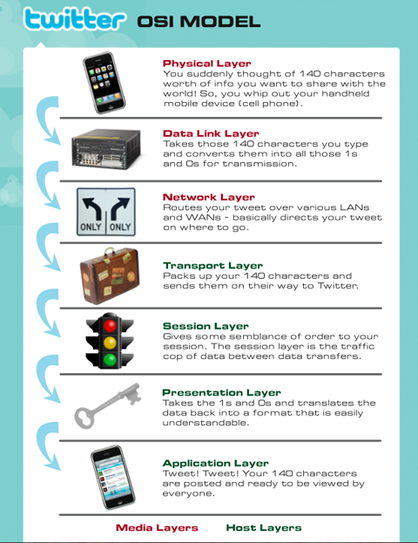
Loosely translated Tweet using the OSI model

Slide 8
OSI Model
 | Data unit | Layer | Function
Host layers | Data | 7. Application | Network process to application (end user layer)
 |  | 6. Presentation | Data representation, syntax layer, encryption and decryption, convert machine dependent data to machine independent data
 |  | 5. Session | Interhost communication (logical ports)
 | Segments | 4. Transport | End-to-end connections and reliability, (Host to Host, Flow control)
Media layers | Packet | 3. Network | Path determination and logical addressing (“letter” containing IP address)
 | Frame | 2. Data Link | Physical addressing (“Envelopes” contain MAC address)
 | Bit | 1. Physical | Media, signal and binary transmission (cables, hubs etc)
DoD Model
Process
Host to Host
Internet
NW Access
Physical

Slide 9
This Class
IT Components
LANS
Parts
Why and how they are used in the enterprise
WANs
Types
Services

Slide 10

Definitions
Communications
Packet Switched
Packet switching entails packaging data in specially formatted units (packets ) that are routed from source to destination using network switches and routers . Each packet contains address information that identifies the sending computer and intended recipient.
Circuit Switched
Circuit-switching is where a physical path is obtained for and dedicated to a single connection between two end-points in the network for the duration of the connection.
Media
Types
Structured Cabling Design
LAN, WLAN
WAN
Notes:
Packet switching entails packaging data in specially formatted units (packets ) that are routed from source to destination using network switches and routers . Each packet contains address information that identifies the sending computer and intended recipient.
Circuit-switching is where a physical path is obtained for and dedicated to a single connection between two end-points in the network for the duration of the connection.

Slide 11
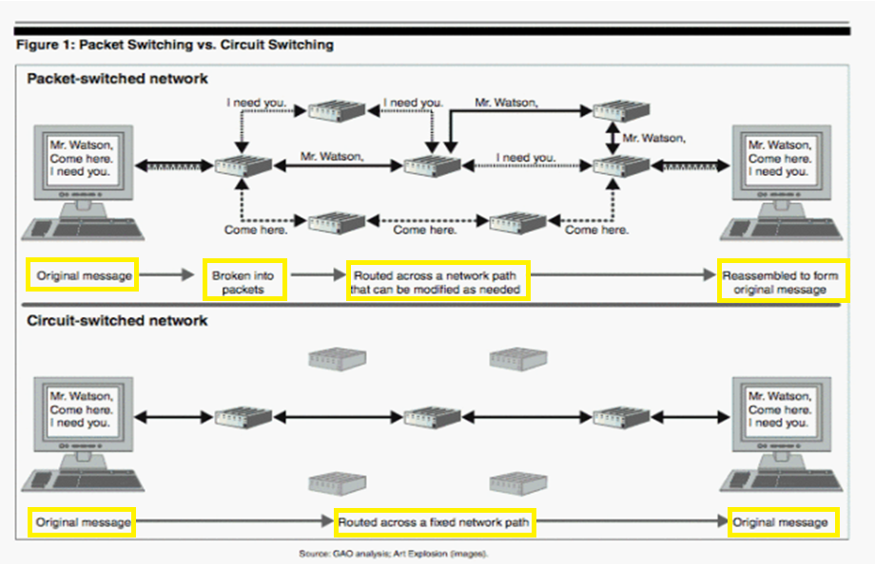
Comparison of Packet and circuit Switching
Notes:
Nowadays there is a convergence of these two types (think VoIP) of communication switching but primarily packet switching has traditionally been for data and circuit switching has been for voice

Slide 12
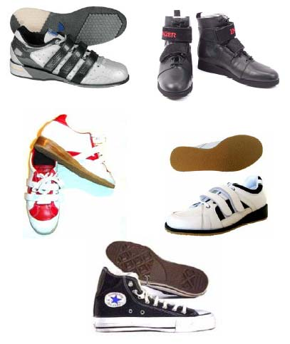
Let’s start with the Local Network
What makes a local area network, local?
And what do tennis shoes have to do with it?

Slide 13
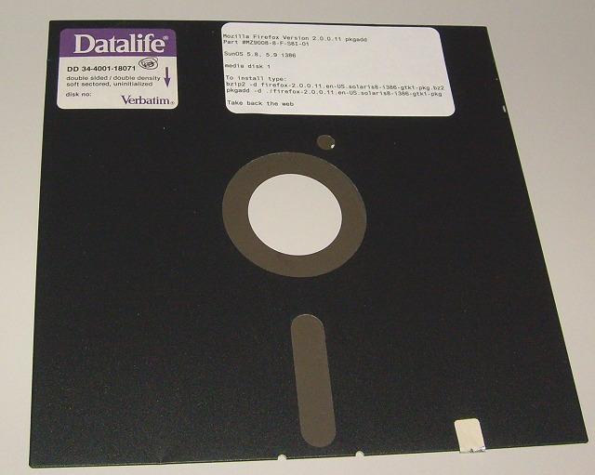
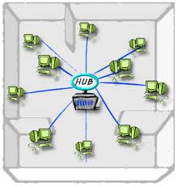
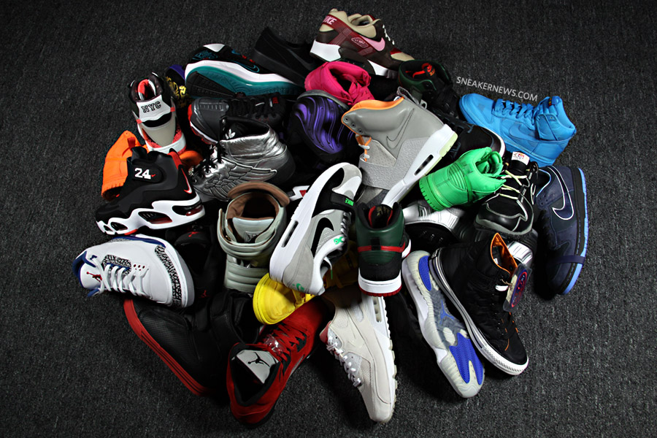
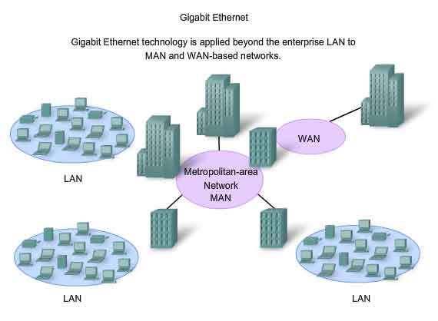
LANs – a brief history
Sneakernet
Small LANs
Enterprise LANs

Slide 14
Parts
What are the parts of a local area network?
Physical connections (media)
Nodes
Interconnectivity Hardware (hubs, switches, routers)
Customer Premise Equipment

Slide 15
What Services are provided by the LAN
Access
Sharing (of resources)
Data
Applications,
Storage
Centralized access control/authentication
Printing
Internet
Applications

Slide 16
Enterprise Applications
Depending on the enterprise
Transaction Processing systems
ERP
Information Systems
Email
Streaming video/audio (training, meetings)
Collaboration tools

Slide 17
Cabling

Slide 18

Reality Check
While we are starting at the bottom of the OSI model
In reality you would start at the TOP
Define the types of applications that must be used in the organization
Define the quantity and quality of the traffic generated by those applications
These will inform all of the decisions – Top Down

Slide 19
Physical Layer
Layer Decision: Cabling – Wired or wireless (i.e. – guided and unguided)?
If wired, what kind of cabling do we use?
Twisted pair Cu
Coaxial (coax) -- not really a choice for LAN
Fiber Optic (fiber)

Slide 20
Media
Guided
Media
Unguided
Media
Coax
Cable
Twisted
Pair
Fiber
Optics
Infrared
Radio
Frequency

Slide 21
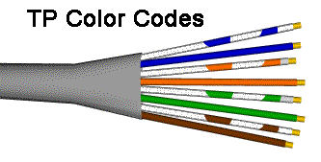
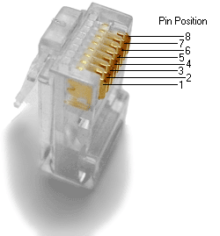
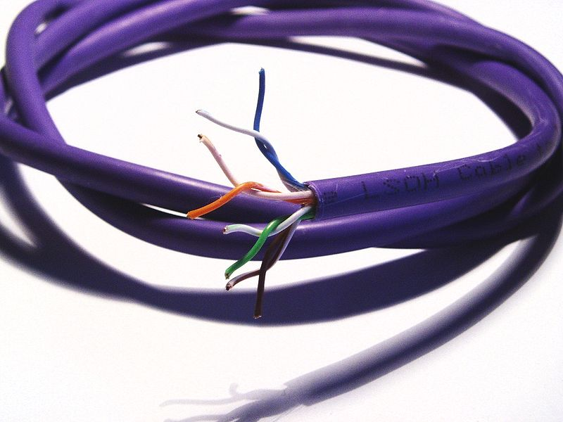
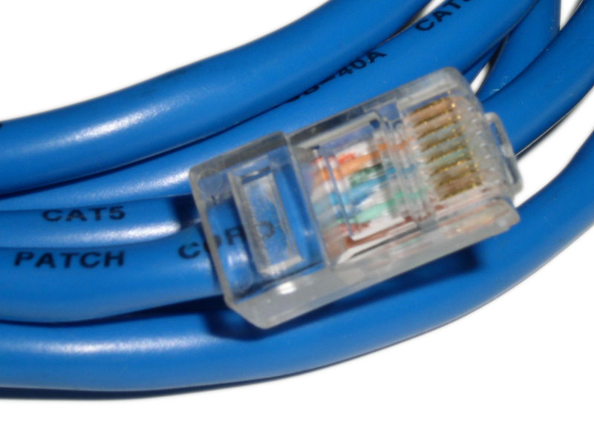
Two wiring plans (stds) 568A & 568B
http://www.infocellar.com/networks/cables/twisted-pair-cables.htm

Slide 22
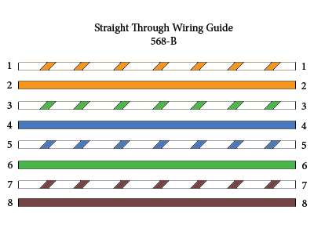
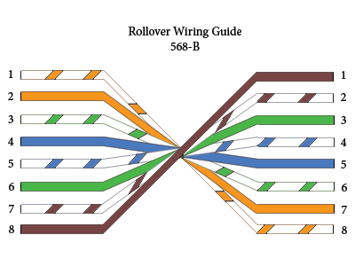
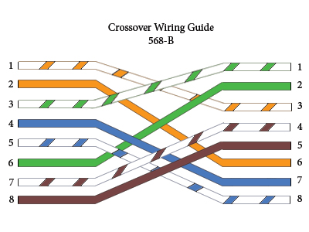
Cable Types
Notes:
Straight through cabling is most common.
Cross over cabling is used when connecting two hosts– For Example two computers
Roll over cabling (Cisco console) is used to connect to a devices console port to make programming changes to the device. They are not used to carry data.

Slide 23
Cu (copper) Cabling Type Standards
Cat 1: Retired. Previously used for POTS telephone communications, ISDN and doorbell wiring. Max rate 1 Mbps
Cat 2: Retired. Was used on IBM token ring networks. Max rate 4 Mbps
Cat 3: Historically popular for 10 Mbit/s Ethernet networks. Max rate 16 Mbps
Cat 4: Retired. Was frequently used on IBM token ring networks. Max rate 20 Mbps
Cat 5: Is used on 100 BaseT Ethernet networks, with four pair wires may be used for GigaE, runs at 100 Mhz but…
Cat 5e: Provides more shielding and is the better choice for GigaE networks. Max rate is 1000 Mbps (still running a 100 Mhz).
Cat 6: May provide better than GigaE performance (up to 250 MHz).
Cat 6a: Specification for 10 Gbps applications (up to 500 MHz).
Cat 7: Future specification for transmission at frequencies up to 600 MHz.
Cat 7a: Future specification to 1,000 MHz
CU=Copper

Slide 24
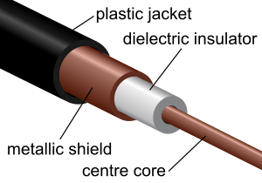
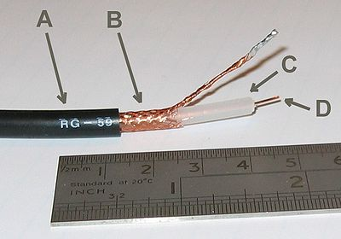
Transmission media: coaxial cable
A
C
B
D
One copper conductor within a tubular conducting shield. The generated energy fields are contained by the outer conductor.

Slide 25
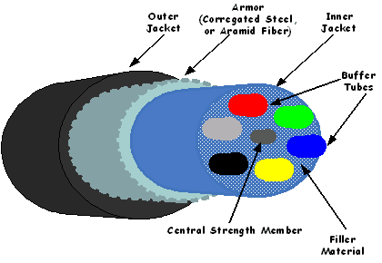
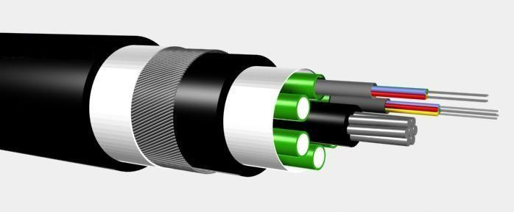
Transmission media: fiber optic cable
One or more optical “light pipes” within a tubular conductor. Cladding contains laser-generated light within the optic channel. Lasers are modulated with digital signals.

Slide 26

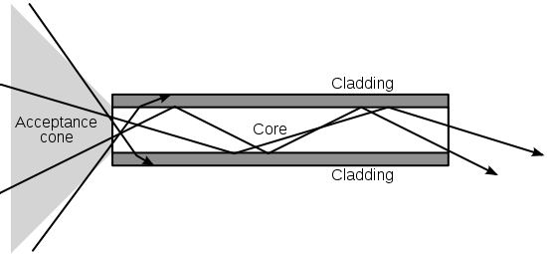
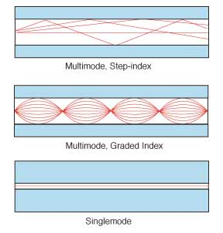
Modes of Fiber
Single Mode
Multi-Mode
Bendable fiber
http://www.youtube.com/watch?v=mUBRjiVhJTs
http://www.youtube.com/watch?v=VpBX_GpuQUA&feature=relmfu
Notes:
STEP-INDEX MULTIMODE FIBER has a large core, up to 100 microns in diameter. As a result, some of the light rays that make up the digital pulse may travel a direct route, whereas others zigzag as they bounce off the cladding. These alternative pathways cause the different groupings of light rays, referred to as modes, to arrive separately at a receiving point. The pulse, an aggregate of different modes, begins to spread out, losing its well-defined shape. The need to leave spacing between pulses to prevent overlapping limits bandwidth that is, the amount of information that can be sent. Consequently, this type of fiber is best suited for transmission over short distances, in an endoscope, for instance.
GRADED-INDEX MULTIMODE FIBER contains a core in which the refractive index diminishes gradually from the center axis out toward the cladding. The higher refractive index at the center makes the light rays moving down the axis advance more slowly than those near the cladding. Also, rather than zigzagging off the cladding, light in the core curves helically because of the graded index, reducing its travel distance. The shortened path and the higher speed allow light at the periphery to arrive at a receiver at about the same time as the slow but straight rays in the core axis. The result: a digital pulse suffers less dispersion.

Slide 27
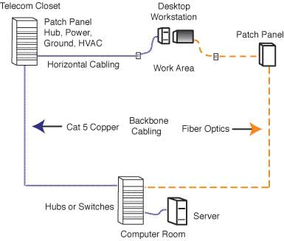
Centralized Fiber LAN

Slide 28
Fiber Optic vs. Copper (TP)
Advantages
Disadvantages
SPEED: Fiber optic networks operate at high speeds - up into the gigabits
BANDWIDTH: large carrying capacity
DISTANCE: Signals can be transmitted further without needing to be "refreshed" or strengthened.
RESISTANCE: Greater resistance to electromagnetic noise such as radios, motors or other nearby cables. Very low error rates.
SECURITY: Not electromagnetic; harder to “listen in” on data transfer. Splices can be easily detected.
MAINTENANCE: Fiber optic cables costs much less to maintain.
COST: Components are expensive. Installation is expensive. Special test equipment is required.
FRAGILE: Susceptible to damage during installation (or disruption.)
STANDARDIZATION: Less standardization across vendors than with copper.
FLEXIBILITY: Cable can’t bend around tight corners.

Slide 29
Good Places for Fiber
Industrial Networks
With lots of Electromagnetic Interference (EMI)
Less than copper in conduit
Long cable runs
Anything > 90 m (~270ft) and you’re almost always better off with fiber

Slide 30
Drawbacks?
Fiber electronics (read switchports) will always be more expensive
If you change out the switch several times over the life of the cable plant – the cost could be significant
PoF – is still not as efficient as over copper
(pof = power over fiber)
Notes:
Fiber is a bad conductor of electricity so it is NOT ideal wherever power is ALSO required.

Slide 31
Is Copper Always less Expensive?
Well, it depends
As compared to what?
Per bit , per device, per foot?
What is included in the cost?
Just cable, ports on devices, repeaters, maintenance, TCO?

Slide 32
Structured Cabling Design
TIA/EIA 568A – Structured Cabling Standard
TIA is the Telecommunications Industry Association which is an offshoot of the Electronic Industries Alliance
It is: Sets of rules that guide for:
size of room
height of ceiling
lighting at 1 m from floor
materials used in the telcom room through the floors, walls, and ceiling

Slide 33

How NOT to install cable

Slide 34
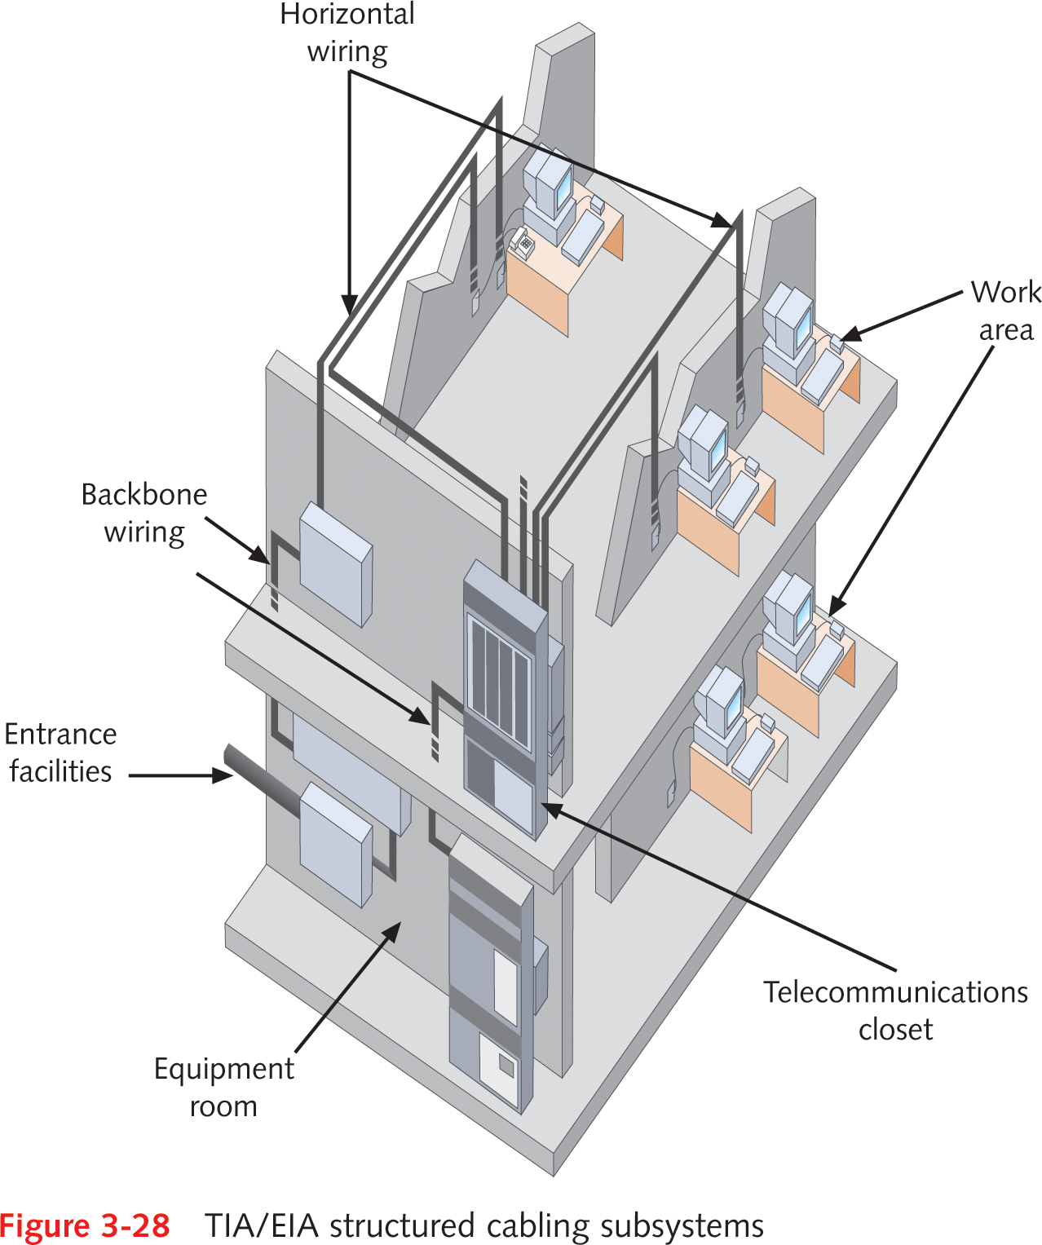
Cable Design and Management
What’s a Cable plant?
Hardware comprising enterprise-wide cabling system
What’s Structured cabling?
Method for uniform, enterprise-wide, multivendor cabling systems

Slide 35
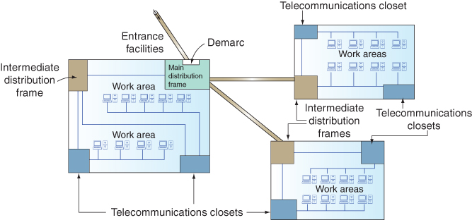
Figure 3-39 TIA/EIA structured cabling in an enterprise
In telephony, the demarcation point is the point at which the public switched telephone network ends and connects with the customer's on-premises wiring.
Notes:
In telephony, the demarcation point is the point at which the public switched telephone network ends and connects with the customer's on-premises wiring.

Slide 36
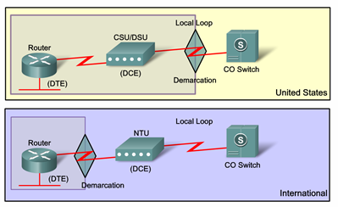
Demarcation
Internationally the Network Termination Unit (NTU) is owned by the service provider.
In the US the service provider doesn’t supply the network termination unit rather the Channel/Data Service Unit (CSU/DSU) is owned by the company/organization.
©Cisco 2010
Notes:
DCE is the Distributed Computing Environment

Slide 37
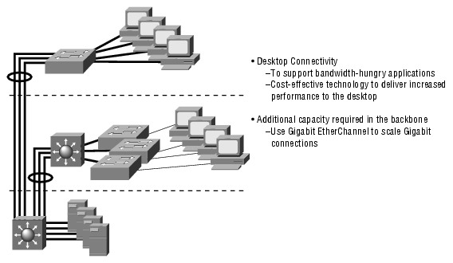
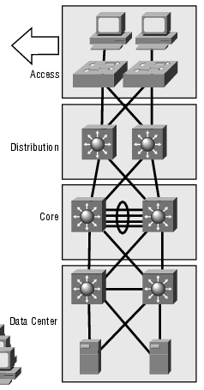
Cabling Design
Access
Distribution
Routing, policy based distribution, filtering happen here
Core/Backbone
Really fast switching of packets to final destination – no routing here, no filtering
©Cisco 2010
Notes:
Also known as the backbone of the network; this is the heart of the network and is responsible for switching huge amounts of traffic very reliably. It must offer high reliability, provide redundancy, provide fault tolerance and avoid slowing traffic down by filtering it in any way.
The distribution layer allows communication between the core and access layers. Packets are manipulated at this layer. The distribution layer should perform certain services such as security, workgroup access routing between LANs, traffic filtering, and redistribution.
The access layer/the desktop layer, this is the point at which end users connect to the network. The access layer allows user access to local segments on the network. Functions performed here include segmenting the network into smaller chunks, sharing bandwidth and local policies for network traffic control.
Breaking networks down into specific layers helps us to understand how they work and also which devices should be performing which functions and features.

Slide 38
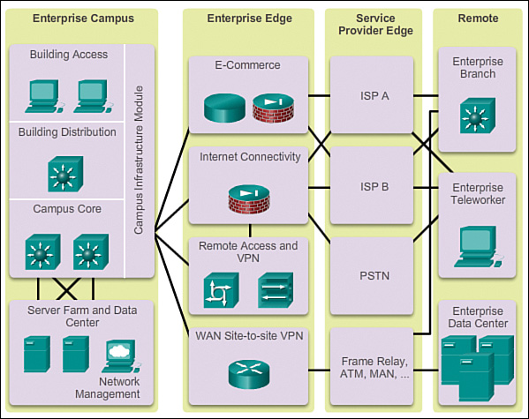
Wider view Hierarchical Design (functional areas)
Enterprise Architecture
©Cisco Enterprise Architecture Modules
Notes:
Enterprise Campus Functional Area
The enterprise campus functional area is intended to be the center of the network design, located at a single location where several different core elements are located and are accessed from all other parts of the network.
Enterprise Edge Functional Area
The enterprise edge functional area is responsible for the aggregation of several different off-campus elements as well as the routing of this traffic into the campus core module within the Enterprise Campus Functional area.
Service Provider Functional Area
The service provider functional area is responsible for connectivity into Service Provider networks. This includes a number of different connectivity options, from Internet access through Public Switched Telephone Network (PSTN) access.
Remote Functional Area
The remote functional area is responsible for connectivity of a number of different remote functional elements, including enterprise branches (connecting through a service provider), enterprise data centers, and enterprise teleworkers.

Slide 39
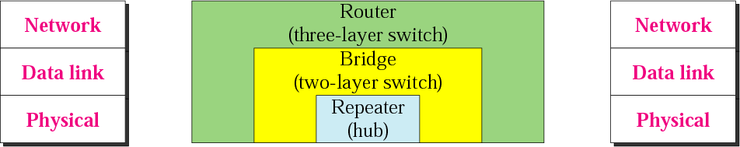
L1 & L2 Networking Connectivity Devices
Hubs (Layer 1)
Bridges (L2, up to 16 ports)
Switches (glorified bridges with up to 100 ports)
Notes:
Hub is the least expensive, least intelligent, and least complicated. Its job is very simple – anything that comes in one port is sent out to the others.

Slide 40
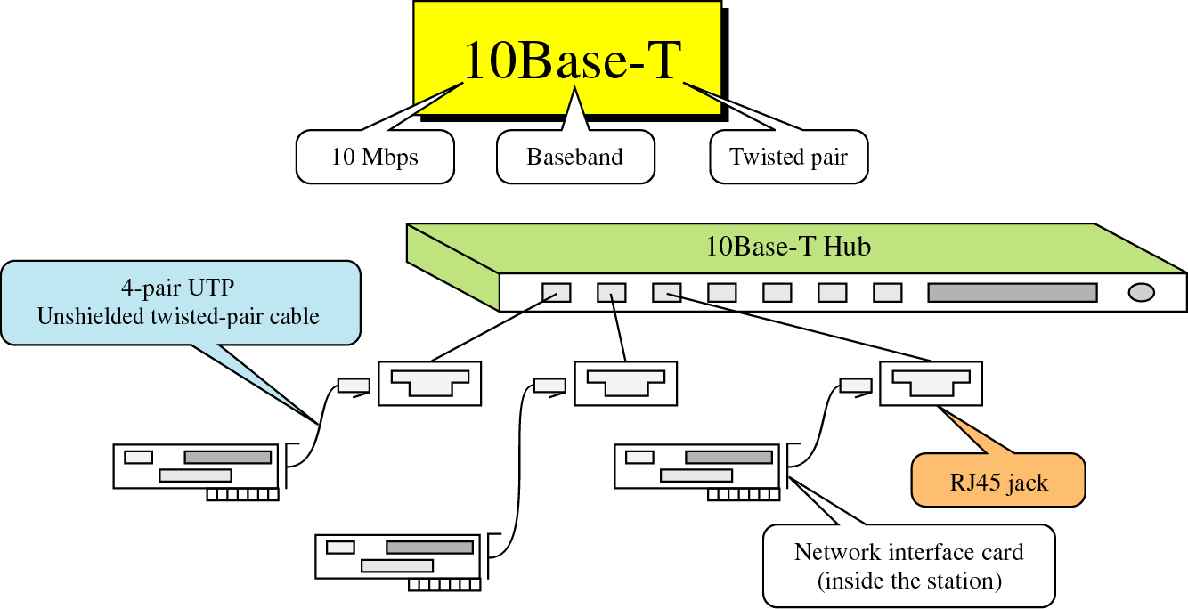
Shared Media environment
Layer-1 device
Repeater: 2-port hub
Connectivity device that regenerates digital signal
Compensates for Noise (Attenuation)
Hub: multi-port repeater, half-duplex
Signal received on one port is broadcast to all other ports
This is mostly what TRU has now, running on 10 Mbps cable.
data

Slide 41
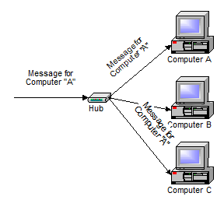
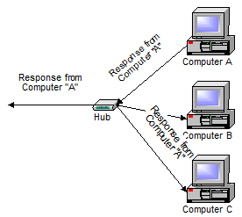
Hubs (multi port repeaters)
A Hub is the least expensive, least intelligent, and least complicated. Its job is very simple – anything that comes in one port is sent out to the others.
If a message comes in for computer “A”, And when computer “A” responds, its response also
that message is sent out all the other ports, goes out to every other port on the hub
regardless of which one computer “A” is on

Slide 42
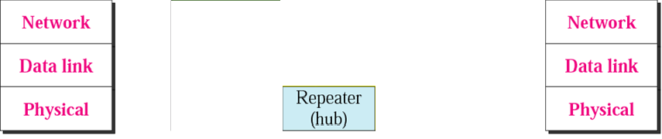
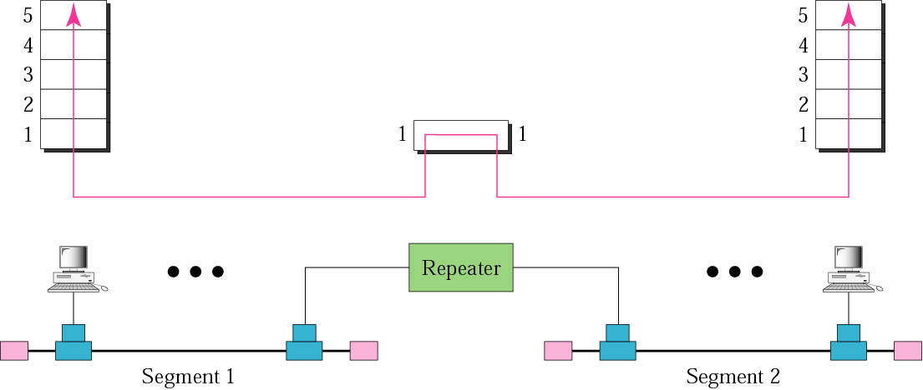
Internetworking Devices
Repeater
Eg. A Hub
Note: A repeater connects segments of a LAN together.
It forwards every packet; it has no filtering capability.
0011001010
0011001010

Slide 43
Bridges
Like a repeater, a bridge has typically a single input and single (sometimes multiple) output port
But… Unlike a repeater, it can interpret the data it retransmits
Layer-2 device (reads L 2 addresses)
Advantages over repeaters and hubs
Improved network performance
Breaks up collision domains (the portion of the network in which collisions of frames can occur)
Each interface becomes a collision domain
Notes:
A collision domain is, as the name implies, a part of a network where packet collisions can occur. A collision occurs when two devices send a packet at the same time on the shared network segment. The packets collide and both devices must send the packets again, which reduces network efficiency.

Slide 44
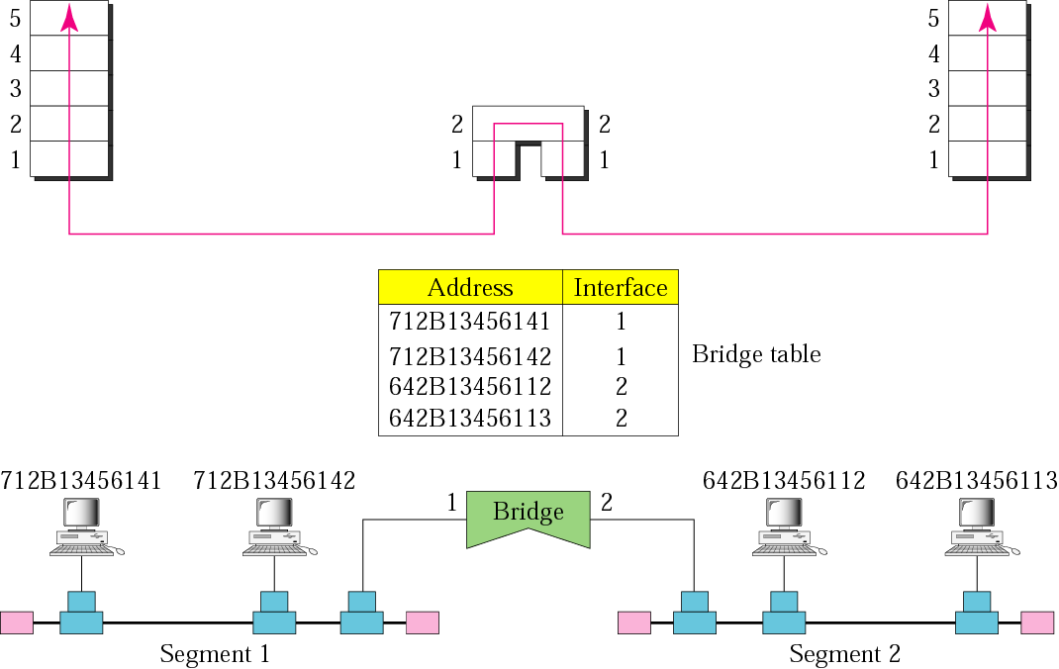
Bridge:
Connect LAN segments together
Read only the destination address of each Ethernet packet or Token Ring frame for maximum speed and efficiency
has a table used in filtering decisions
Forward/Learn Process
0011001010
0011001010
H
H
Notes:
Connect two parts of the same network. Read only the destination address of each Ethernet packet or Token Ring frame for maximum speed and efficiency.

Slide 45
Switches
These devices are Bridges with “marketing”
They operate in much the same way (but in hardware, and MUCH faster)
Most are full duplex
They are optimized to filter and forward VERY quickly
Cut-thru
Store and forward
Fragment free

Slide 46
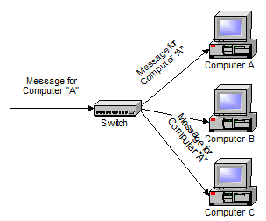
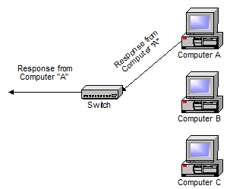
Switches
A Switch does essentially what a hub does, but more efficiently.
Initially, a switch knows nothing and simply sends on incoming messages to all ports
Even accepting that first message, however, the switch has learned something – it knows on which connection the sender of the message is located. Thus, when machine “A” responds to the message, the switches only need to send that message out to the one connection

Slide 47
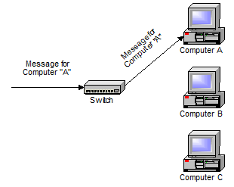
Switches
In addition to sending the response through to the originator, the switch has now learned something else – it now knows on which connection machine “A” is located. That means that subsequent messages destined for machine “A” need only be sent to that one port

Slide 48
Network Topology Forms
What are the pathways packets take?

Slide 49
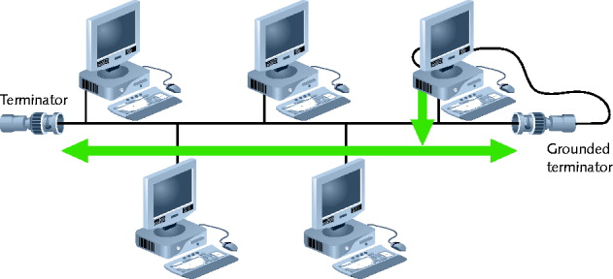
Simple Physical Topologies
Physical topology
Physical layout of a network
A Bus topology consists of a single cable, called a bus, connecting all nodes on a network without intervening connectivity devices
A terminated bus topology network

Slide 50
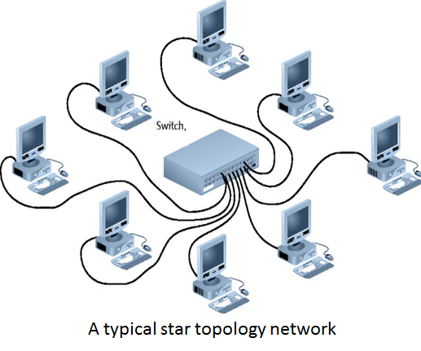
Star Topology
Every node on the network is connected through a central device
Physical medium
Twisted pair or fiber-optic cabling
Most popular fundamental layout

Slide 51
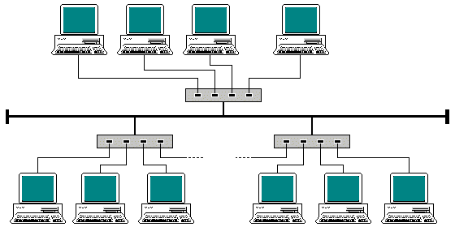
Star-wired Bus Topology
In a star-wired bus topology, groups of workstations are star-connected to hubs and then networked via a single bus
Bus (no nodes)

Slide 52
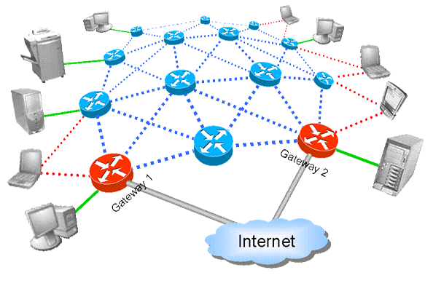
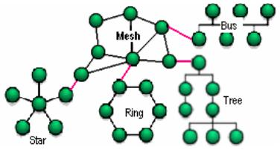
Network topology: Mesh
Advantages/Disadvantages
Decentralized
Expensive
Reliable and resilient
Network can span large distances
Increase capacity by adding more nodes
Fixed or mobile devices

Slide 53
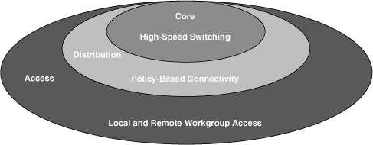
Backbone Networks
The backbone network is an important architectural element for building enterprise networks.
It provides a path for the exchange of information between different LANs or subnetworks.
A backbone can tie together diverse networks in the same building and/or different buildings and campus environments, or over wide areas.
It is mostly cabling connecting hubs, switches, routers
There is significantly more throughput - “bigger pipes”
Large organizations usually have
Fiber-optic backbone
Cat 5e or better for hubs, switches
Enterprise-wide network backbones
Complex, difficult to plan
Affect the Entire organization
Are a significant building block

Slide 54
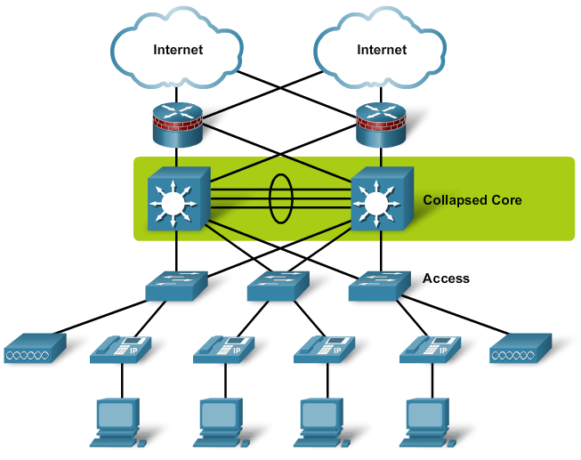
Collapsed Core Backbone Network
Collapsed ::= divide a single collision domain into multiple ones
Uses a router or switch as the single central connection point for multiple sub networks
ease of management since the backbone is in a single location and in a single box
since the backbone essentially uses internal switching matrix of the box, proprietary, high performance technology can be used.
Enterprise Edge
©Cisco 2010
Notes:
Single central connection point for multiple subnetworks. Uses a router or switch
Router with multiprocessors
Risks are
Central router failure
Routers may slow data transmission
Advantages
Interconnect different sub network types
Central management

Slide 55
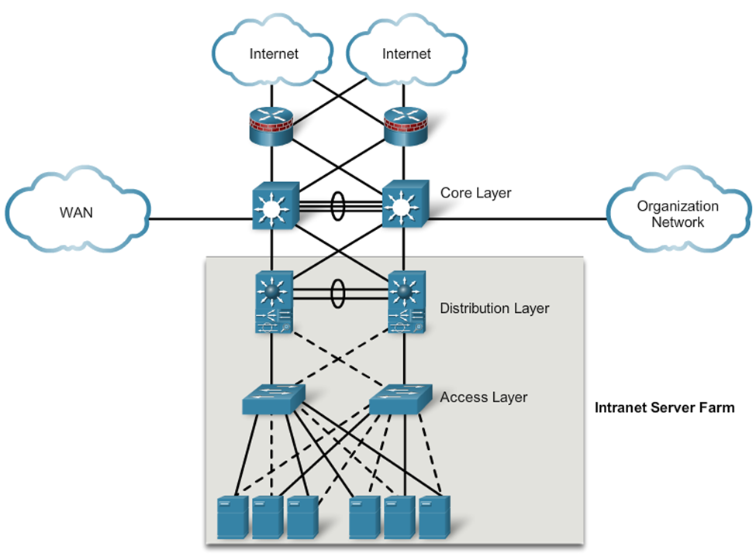
Intranet Server Farm
©Cisco 2010

Slide 56
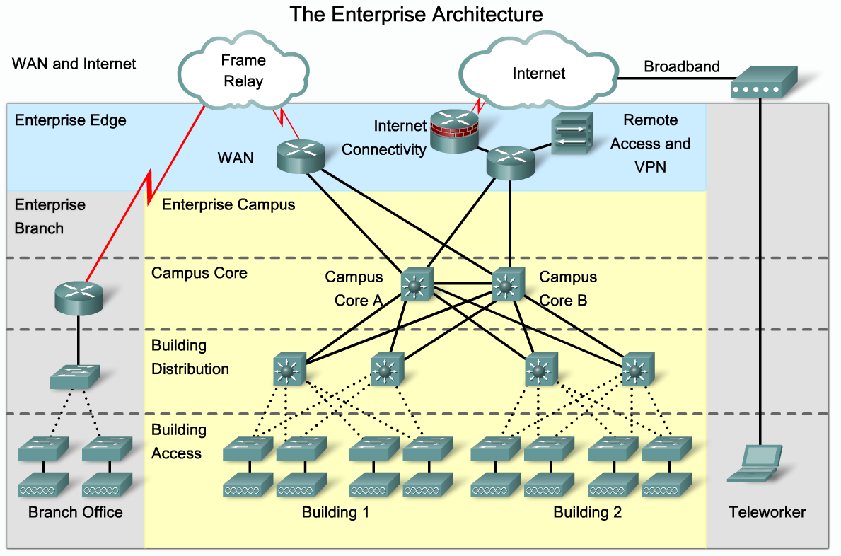
Enterprise Architecture
©Cisco 2010

Slide 57
Network Access Layer
Ethernet DSL ISDN FDDI PPP
Do we have a universal standard for communication at the lower layers of the model inside the enterprise?
Ethernet is pretty much the only standard in use today

Slide 58
Wireless Local Area Networking
(Wi-Fi)

Slide 59
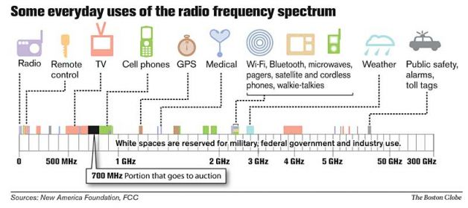
The Wireless Spectrum
This Auction by the FCC happened in 2008. the next Auction for the 600Mhz spectrum will occur in 2015
Guess who were the major participants in the auction?
Why?
Who ended up buying most of the 700Mhz spectrum?
Notes:
Continuum of electromagnetic waves
Data, voice communication
Arranged by frequencies
Lowest to highest
Spans 9 KHz and 300 GHz
Wireless services associated with one area
FCC oversees United States frequencies
ITU oversees international frequencies
Air signals propagate across borders

Slide 60

Characteristics of Wireless Transmission
Notes:
Similarities with wired
Layer 3 and higher protocols
Signal origination
From electrical current, travel along conductor
Differences from wired
Signal transmission
No fixed path, guidance
Antenna
Signal transmission and reception
Same frequency required on each antenna
Share same channel

Slide 61

WiFi Signal Propagation
LOS (line-of-sight)
Signal travels
In straight line, directly from transmitter to receiver
Obstacles affect signal travel
Pass through them
Absorb into them
Subject signal to three fading phenomena
Reflection: bounce back to source
Diffraction: splits into secondary waves
Scattering: diffusion in multiple different directions
Notes:
Multipath signals
Wireless signals follow different paths to destination
Caused by reflection, diffraction, scattering
Advantage
Better chance of reaching destination
Disadvantage
Signal delay

Slide 62
Signal Degradation
Fading
Change in signal strength
Electromagnetic energy scattered, reflected, diffracted
Attenuation
Signal weakens
Moving away from transmission antenna
Correcting signal attenuation
Amplify (analog), repeat (digital)
Noise
Significant problem
No wireless conduit or shielding possible
Notes:
Fading signal problem

Slide 63
Frequency Ranges
2.4-GHz band (older)
Frequency range: 2.4–2.4835 GHz
11 unlicensed communications channels
Susceptible to interference
Unlicensed
No FCC registration required
5-GHz band (newer)
Frequency bands
5.1 GHz, 5.3 GHz, 5.4 GHz, 5.8 GHz
24 unlicensed bands, each 20 MHz wide
Used by weather, military radar communications

Slide 64
Narrowband, Broadband, and Spread Spectrum Signals
Defines wireless spectrum use:
Narrowband
Transmitter concentrates signal energy at single frequency, very small frequency range (think telephones)
Broadband
Relatively wide wireless spectrum band
bandwidth is shared by more than one simultaneous signal
Higher throughputs than narrowband
Spread-spectrum
Multiple frequencies used to transmit signal
Offers noise reduction, security and resistance to jamming/interception
Orthagonol (OFDM)
Uses multiple carrier frequencies for increased throughput
OFDM uses many narrow band signals (think digital TV)
Notes:
Orthogonal frequency-division multiplexing (OFDM) is a method of encoding digital data on multiple carrier frequencies. OFDM has developed into a popular scheme for wideband digital communication, whether wireless or over copper wires, used in applications such as digital television and audio broadcasting, DSLbroadband internet access wireless networks, and 4G mobile communications.
The term has been extended to general use, meaning the characteristic of being independent (relative to something else). It also can mean: non-redundant, non-overlapping, or irrelevant. In computer terminology, something - such as a programming language or a data object - is orthogonal if it can be used without consideration as to how its use will affect something else.
FHSS (frequency hopping spread spectrum)
Signal jumps between several different frequencies within band
Synchronization pattern known only to channel’s receiver, transmitter
DSSS (direct-sequence spread spectrum)
Signal’s bits distributed over entire frequency band at once
Each bit coded
Receiver reassembles original signal upon receiving bits

Slide 65
Fixed versus Mobile
Mobile communications wireless systems
Receiver located anywhere within transmitter’s range
Receiver can roam
WiFi and Cellular networks
Fixed communications wireless systems
Transmitter, receiver locations do not move
Transmitting antenna focuses energy directly toward receiving antenna
Point-to-point link results
Advantage
No wasted energy issuing signals
More energy used for signal itself
Used in Bldg to Bldg communications

Slide 66


wLAN Architecture
An ad hoc WLAN
An infrastructure WLAN
Notes:
Ad hoc WLAN
Wireless nodes transmit directly to each other
Use wireless NICs
No intervening connectivity device
Poor performance
Many spread out users, obstacles block signals
Access point (AP)
Accepts wireless signals from multiple nodes
Retransmits signals to network
Base stations, wireless routers, wireless gateways

Slide 67
wLAN Architecture (cont’d.)
Infrastructure wLAN
Stations communicate with access point
Not directly with each other
Access point requires sufficient power, strategic placement
wLAN may include several access points
Dependent upon number of stations
Maximum number varies: 10-100

Slide 68
802.11 wLAN Standard
Wireless technology standard
Describes unique functions
Physical and Data Link layers
Differences
Specified signaling methods, geographic ranges, frequency usages
Developed by IEEE’s 802.11 committee
Wi-Fi (wireless fidelity) standards
802.11b, 802.11a, 802.11g, 802.11n, 802.11ac
Share characteristics
Half-duplexing, access method, frame format
Notes:
Institute of Electrical and Electronics Engineers

Slide 69

AP Management – Site Survey

Slide 70
WiFi Access Method
802.11 MAC services
Append 48-bit (6-byte) physical addresses to frame
Identifies source, destination
Same physical addressing scheme as 802.3
Allows easy combination
Wireless devices
Not designed for simultaneous transmit, receive
Cannot quickly detect collisions
Use different access method (CSMA/CA)
Notes:
802.3 is the ethernet standard from IEEE
CSMA/CA (Carrier Sense Multiple Access with Collision Avoidance)

Slide 71

Carrier Sense Multiple Access with Collusion Avoidance CSMA/CA
Notes:
RTS is request to send
CTS is clear to send

Slide 72
Collision Avoidance: RTS-CTS exchange
Src
AP
Other Nodes
DIFS
RTS(A)
SIFS
CTS(A)
CTS(A)
SIFS
DATA (A)
time
SIFS
defer
ACK(A)
ACK(A)
DIFS= Distributed Coordinated Function IFS
SIFS = Short IFS
Notes:
CSMA/CA (Carrier Sense Multiple Access with Collision Avoidance)
Minimizes collision potential
Uses ACK packets to verify every transmission
Requires more overhead than 802.3
Real throughput less than theoretical maximum
RTS/CTS (Request to Send/Clear to Send) protocol
Optional
Ensure packets not inhibited by other transmissions
Efficient for large transmission packets
Further decreases overall 802.11 efficiency

Slide 73
Association
Using a SSID (service set identifier)
Unique character string identifying access point
In beacon fame information
Configured in access point
Better security, easier network management
BSS (basic service set)
Station groups sharing access point
BSSID (basic service set identifier)
Station group identifier
Notes:
Packet exchanged between computer, access point
Gain Internet access
Scanning
Surveying surroundings for access point
Active scanning transmits special frame
Probe
Passive scanning listens for special signal
Beacon fame

Slide 74
Association (cont’d.)
ESS (extended service set)
Access point group connecting same LAN
Share ESSID (extended service set identifier)
Allows roaming
Station moving from one BSS to another without losing connectivity
When several access points detected
Select strongest signal, lowest error rate
Poses security risk
Powerful, rogue access point
Notes:
ESS with several authorized access points
Must allow station association with any access point
While maintaining network connectivity
Reassociation
Mobile user moves from one access point’s range into another’s range
Occurs by simply moving, high error rate
Stations’ scanning feature
Used to automatically balance transmission loads
Between access points

Slide 75


A network with multiple BSSs forming an ESS

Slide 76
802.11g
Affordable as 802.11b
Throughput
54 Mbps theoretical
20 to 25 Mbps effective
100 meter node range
2.4-GHz frequency band
Compatible with 802.11b networks

Slide 77

802.11n
2.4-GHz or 5-GHz frequency range
Same data modulation techniques as b and g
Compared with other 802.11 standards
Manages frames, channels, encoding differently
Allows high throughput
802.11n access point with three antennas using MIMO technique
Notes:
Ratified October 2009
Manufacturers
Selling 802.11n-compatible transceivers
Primary goal
Wireless standard providing much higher effective throughput
Maximum throughput: 600 Mbps
Threat to Fast Ethernet
Backward compatible with 802.11a, b, g standards
MIMO (multiple input-multiple output)
Multiple access point antennas may issue signal to one or more receivers
Increases network’s throughput, access point’s range

Slide 78
802.11n (cont’d.)
Maximum throughput dependencies
Number, type of strategies used
2.4-GHz or 5-GHz band
Actual throughput: 65 to 600 Mbps
Backward compatible
Not all 802.11n features work
Recommendation
Use 802.11n-compatible devices

Slide 79

Latest Version 802.11ac
Gigabit throughputs theoretically possible
290 Mbps and 1300 Mbps
5 GHz range
Makes use of many n techniques
Evolving standard
Consumer 11/2012
Enterprise 11/2013

Slide 80
Bluetooth Networks
Ericson’s original goals
Wireless technology compatible with multiple devices
Require little power
Cover short ranges
Aim of Bluetooth Special Interest Group (SIG)
Refine and standardize technology
Result: Bluetooth
Mobile wireless networking standard using FHSS (frequency hopping spread spectrum) RF signaling in 2.4-GHz band

Slide 81
Bluetooth Networks (cont’d.)
Version 1.1
Maximum theoretical throughput: 1 Mbps
Effective throughput: 723 Kbps
10 meter node difference
Designed for PANs (personal area networks)
Version 2.0 (2004)
Different encoding schemes
2.1-Mbps throughput
30 meters node difference
Usage: cellular telephones, phone headsets, computer peripherals, PDAs

Slide 82

Summary of WLAN Standards
Wireless standards
Notes:
802.11ac is on 5Ghz and has an thoughputs of up to 1300 Mbps (1.3 Gbps)

Slide 83
Memo 1
What do I want?
I want you to go out and learn about cabling options for modern local area networks.
Then demonstrate to me what you learned about LAN cabling by applying that information to the TRU (Times R Us) situation
I’m interested in knowing what should we do. Remember that is doesn’t have to be all one thing or another. Tell me what you learned.
DePaul Writing Center http://condor.depaul.edu/writing

Slide 84
Web Assignment 2 --
Secure your hosted site.
Install WordPress into the /SPRING2015 location (it MUST be available at http://yourdomain.suffix/SUMMER2015 or http://yourname.siteground.net/SUMMER2015
Write your first post (your context document)
Submit to D2L dropbox
Your url in a Word readable document (no PDF for this assignment please). If you must just submit the URL in the comments section of the dropbox and a blank file.

Slide 85
Website Project -- Discussion
Assignment 1 -- context
This will define the context for your website
You may choose to do TRU (the company for the memos) or you may choose to do a personal blog
In any case you must answer these three questions
What community do you plan to serve (who will make comments and why)?
What value would your site provide (why would people return to your site over and over again)?
Who would be responsible for writing content on your fictional blogsite (besides you, assuming this isn’t about YOU)?

Slide 86

Discuss

Slide 87
How do I connect my locations into an Enterprise?
If we run local systems on Local Area Networks
We connect widely separate networks with a
Wide Area Network

Slide 88

What is a WAN
©Cisco 2010

Slide 89

WAN Physical Layer Terms
©Cisco 2010

Slide 90

WAN Options
©Cisco 2010

Slide 91


WAN Options
©Cisco 2010
Notes:
CSU/DSU- Channel Service Unit/Data Service Unit

Slide 92

WAN Protocols
©Cisco 2010
Notes:
HDLC- High Level Data Link Control
PPP –Point to Point Protocol
SLIP-Serial Line Internet Protocol
ATM-Asynchronous Transfer Mode

Slide 93
Do we have a universal standard for communication at the lower layers of the model outside the enterprise?
Network Access Layer
Ethernet DSL ISDN FDDI PPP
Frame Relay, MPLS (multi protocol label switching), Metro Ethernet, DSL, PPP, ATM
Notes:
MPLS – Multi Protocol Label Switching
DSL- Digital Subscriber Line
PPP –Point to Point Protocol
ATM-Asynchronous Transfer Mode

Slide 94
Leased Lines
Dedicated point to point links
Cost is determined by capacity of the link and the distance from the end points
Inflexible, and expensive
You pay for the link, whether or not data is travelling at link capacity
Highly secure as your data is only stuff on the link

Slide 95

Types of T-Carriers – Leased Lines
Table 7-1 Carrier specifications
T1 use
Connects branch offices, connects to carrier
Connects telephone company COs, ISPs
Costs vary per region but a rough ballpark about $1000- $1500 per month
T3 use
Data-intensive businesses
Costs also vary but can range form $10K-$30K (or even more) per month
T3 provides 28 times more throughput
Multiple T1’s may accommodate needs

Slide 96
T- Carrier
How much throughput do I need?
T1: good for about 25 users doing regular office work (~5 power users)
Bundle T1s to increase capacity
T3 (28 T1s): ~600 regular users, ~150 power users

Slide 97


How does data get from one point to another?
Circuit Switching is when two nodes establish a dedicated communication channel for the duration of a session.
The Public Switched Telephone Network (PSTN) uses this (well, used to).
Packet Switching is when information is sent across shared channels inside of blocks (or packets).
The Internet uses this.

Slide 98


Circuit vs Packet
Circuit is DEDICATED and SESSION BASED
Circuit goes via dedicated path
packet IS BLOCKS OF DATA (think internet)
Packet finds the shortest distance through the network
©Cisco 2010

Slide 99
Circuit Switching
Connection established between two network nodes
Before transmitting data
Dedicated bandwidth
All Data follows same path selected initially by switch
Monopolizes bandwidth while connected
Resources wasted
Uses
Live audio, videoconferencing
Home modem connecting to ISP

Slide 100
Packet Switching
Most popular
Breaks data into packets before transporting
Packets
Travel any network path to destination
Find fastest circuit available at any instant
Need not follow each other
Need not arrive in sequence
Must be Reassembled at destination
Requires speedy connections for live audio, video transmission

Slide 101
Packet Switching
Advantages
No wasted bandwidth
Devices do not process information
Examples
Ethernet networks
Internet

Slide 102
Frame Relay Overview
DCE or Frame Relay Switch
Frame Relay
Router
CSU/DSU
Provider network
Ethernet LAN
Virtual circuit connections
One physical circuit
Multiple virtual circuits
Connection-oriented service
Permanent Virtual Circuit (PVC)
Notes:
Frame relay is a standardized wide area network technology that specifies the physical and logical link layers of digital telecommunications channels using packet switching methodologies
Frame relay puts data in a variable-size unit called a frame and leaves any necessary error correction (retransmission of data) up to the end-points, which speeds up overall data transmission. For most services, the network provides a permanent virtual circuit (PVC), which means that the customer sees a continous, dedicated connection without having to pay for a full-time leased line, while the service provider figures out the route each frame travels to its destination and can charge based on usage.

Slide 103
Frame Relay (cont.)
Address: Data Link Connection Identifier (DLCI), 10-bit, local significance.
CIR (committed information rate)
Guaranteed minimum amount of bandwidth selected when leasing a frame relay circuit
Can burst higher than CIR
Users get more than they pay for.
burst
(512k)
CIR
(768k)

Slide 104

MPLS
Multi-Protocol Label Switching
A more efficient way to forward and route packets
Label Edge Router (LER)
Analyzes each packet on arrival to the MLPS network and puts on a wrapper which tells each router where to forward the packet without reading the header (just the wrapper)
84 % of companies with a WAN are using MPLS
Label | Traffic class/QOS/ECN | TTL | BOS
20 bits | 3 bits | 8 bits | 1 bit
Notes:
MPLS can be considered a Layer 2.5 networking protocol.
MPLS was created in the late 1990’s to avoid having routers waste time by having to stop and look up routing tables. The protocol allows most packets to be forwarded at the Layer 2 (switching) level rather than at the Layer 3(routing) level. Each packet gets labeled at the edge of the service provider's network and that label determines which pre-determined path the packet will follow. The paths, which are called label-switched paths (LSPs), allow service providers to decide ahead of time what will be the best way for certain types of traffic to flow within a private or public network. LSPs are virtual links
MPLS is protocol-independent.

Slide 105

MPLS Components

Slide 106

MPLS – Outside Traffic movement
Best parts of circuit switch and packet switch
Uses Labels to select predetermined “routes”
Uses circuit-like techniques within ISP, and packet within Customer
Deploys VPN like features (customer packets remain “private”

Slide 107



MPLS and the Internet

Slide 108

Connecting to MPLS

Slide 109
Multi-Service Ethernet
Ethernet connection into the WAN provider network
Use the big pipe for:
MPLS, P2P or ethernet LAN, SIP (voice) trunks
Outbound only

Slide 110
Due this week
1 post and 2 comments on d2l discussion
Submit to D2L your Web Assign 1
Research Memo 1 (be ready to discuss next week
Work on Web Assign 2 (not due for another week).

